Slide 1
Convolutional Neural Networks- CNN
Kaneeka Vidanage (M. Phil, PhD)

Slide 2
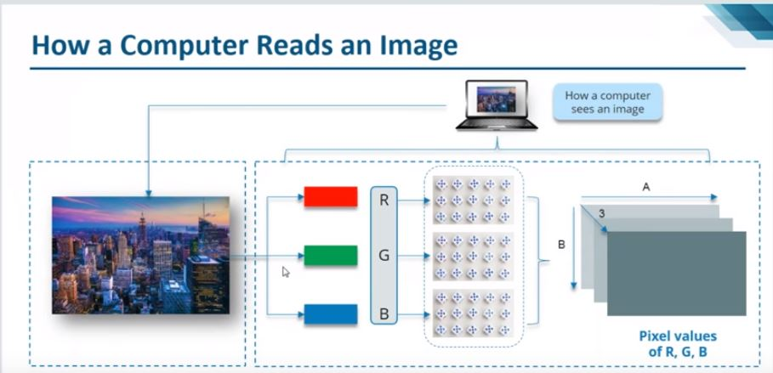

Slide 3
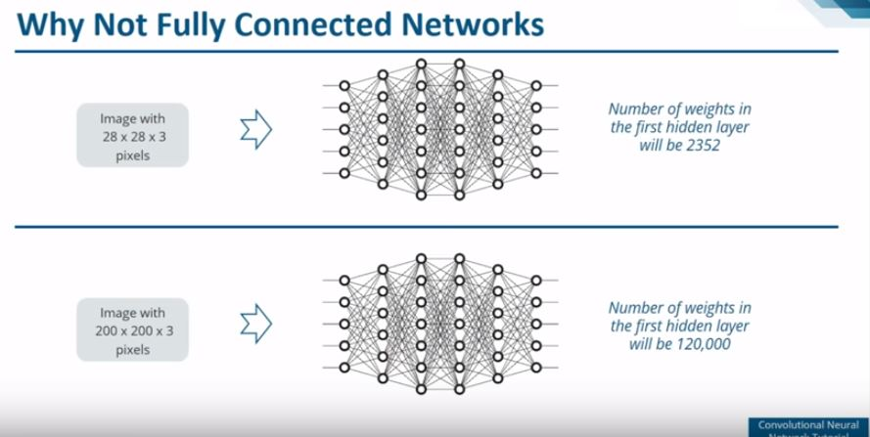

Slide 4
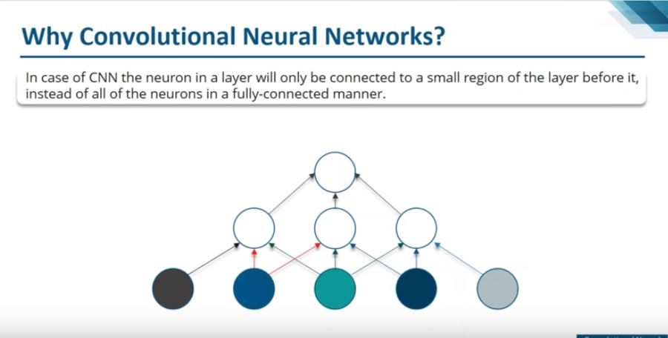

Slide 5
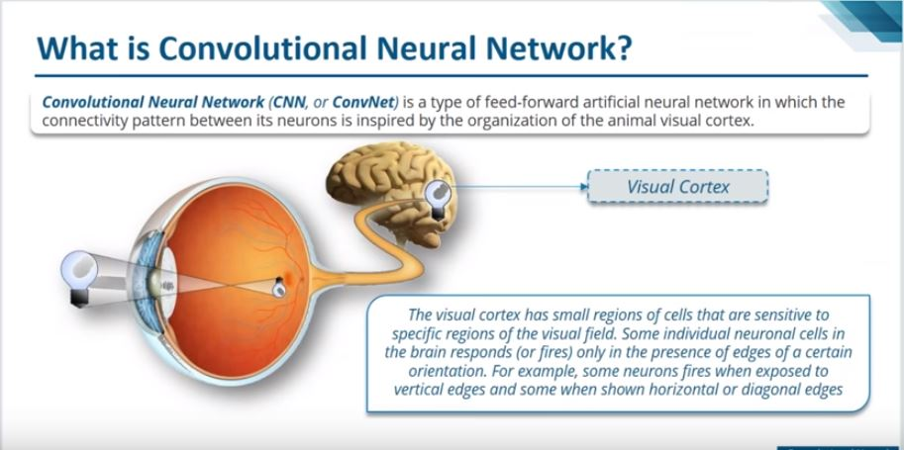

Slide 6
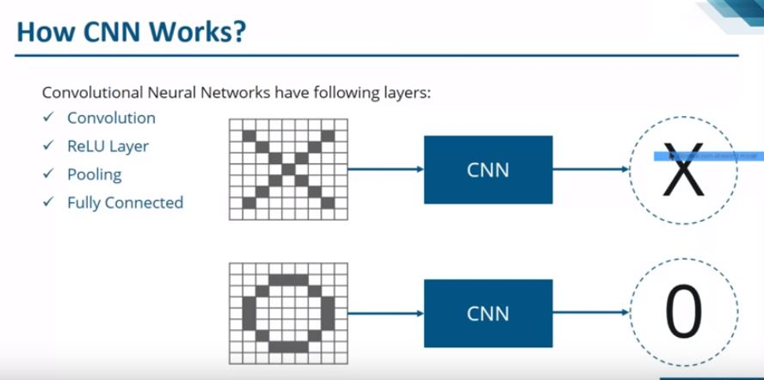

Slide 7
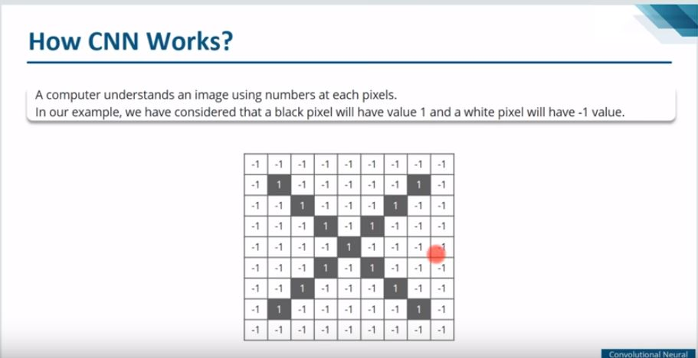

Slide 8
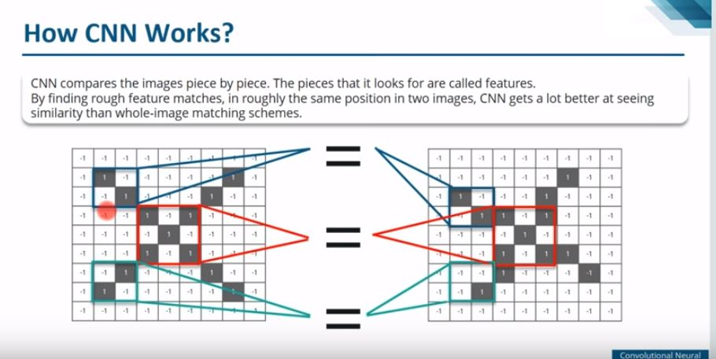

Slide 9
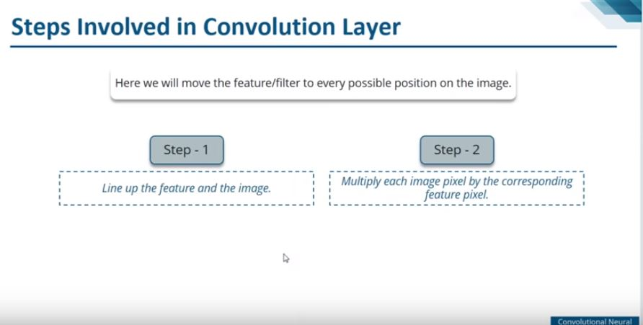

Slide 10
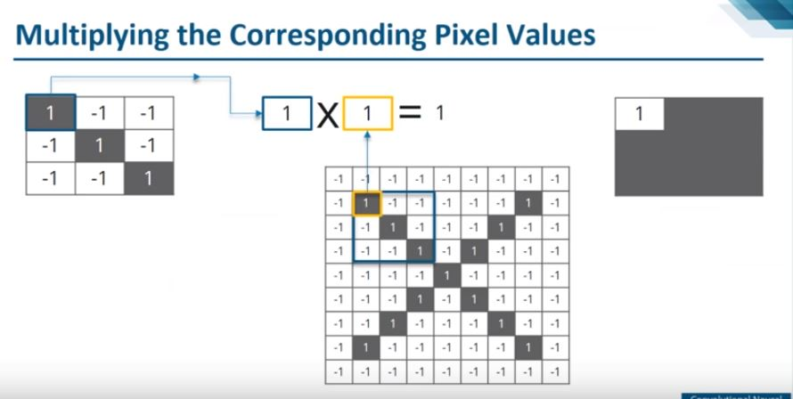

Slide 11
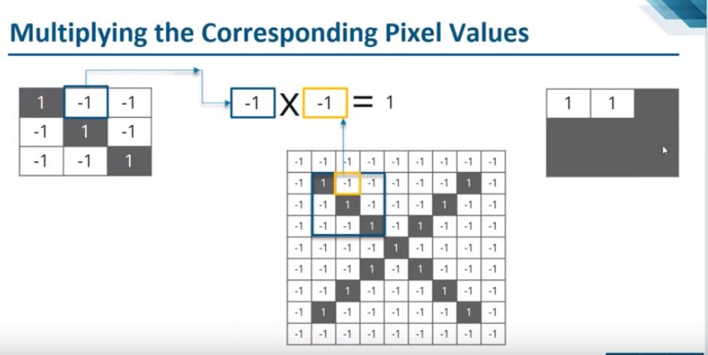

Slide 12
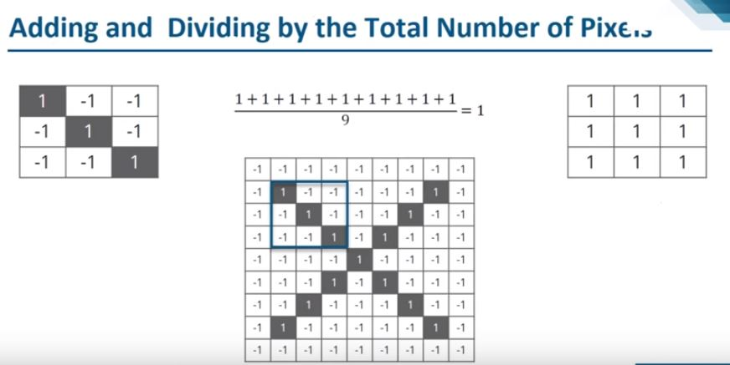

Slide 13
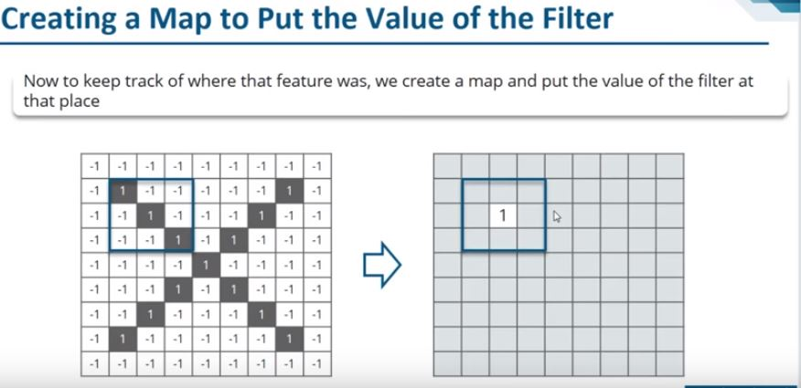

Slide 14
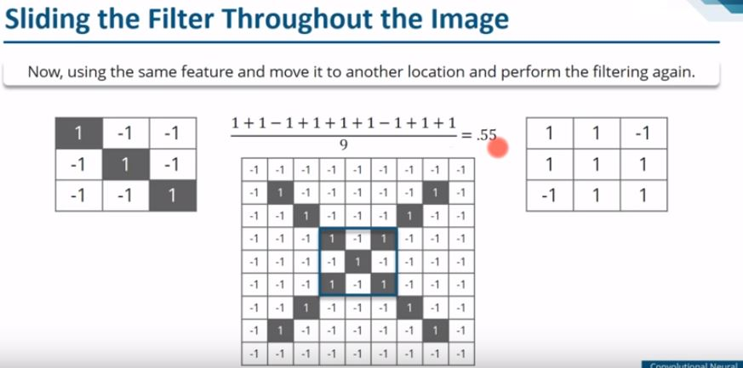

Slide 15
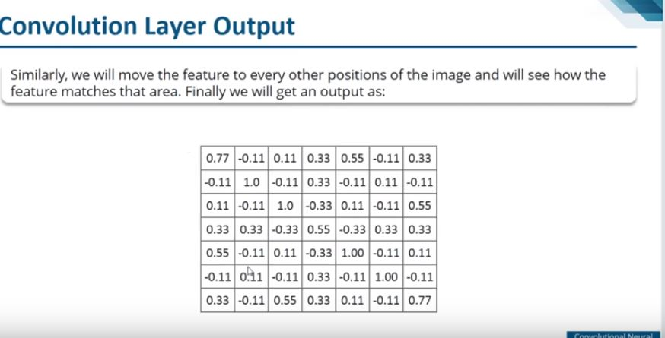

Slide 16
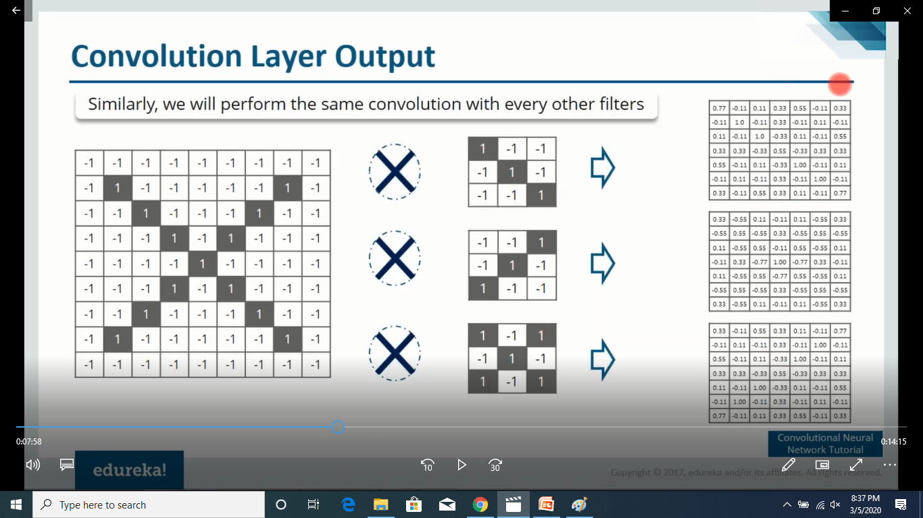

Slide 17
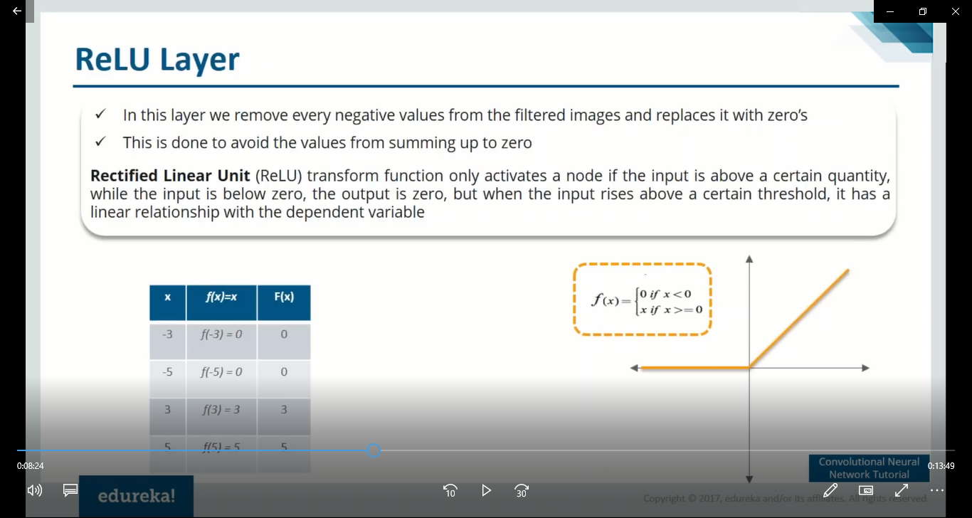

Slide 18
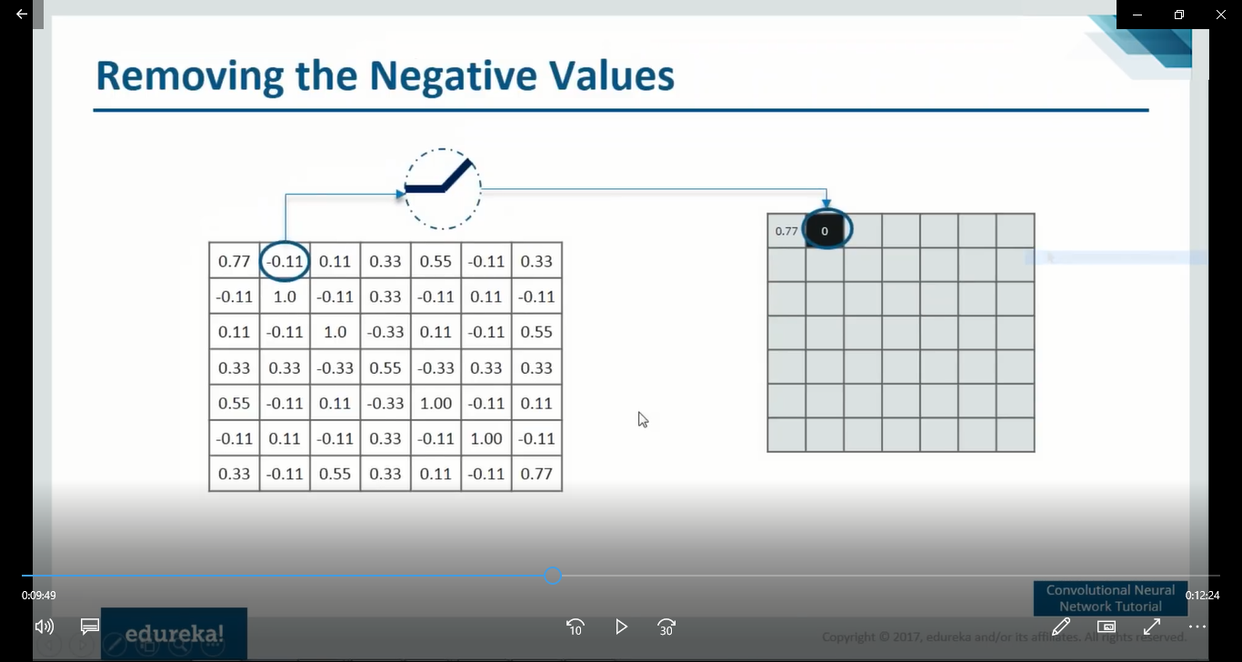

Slide 19
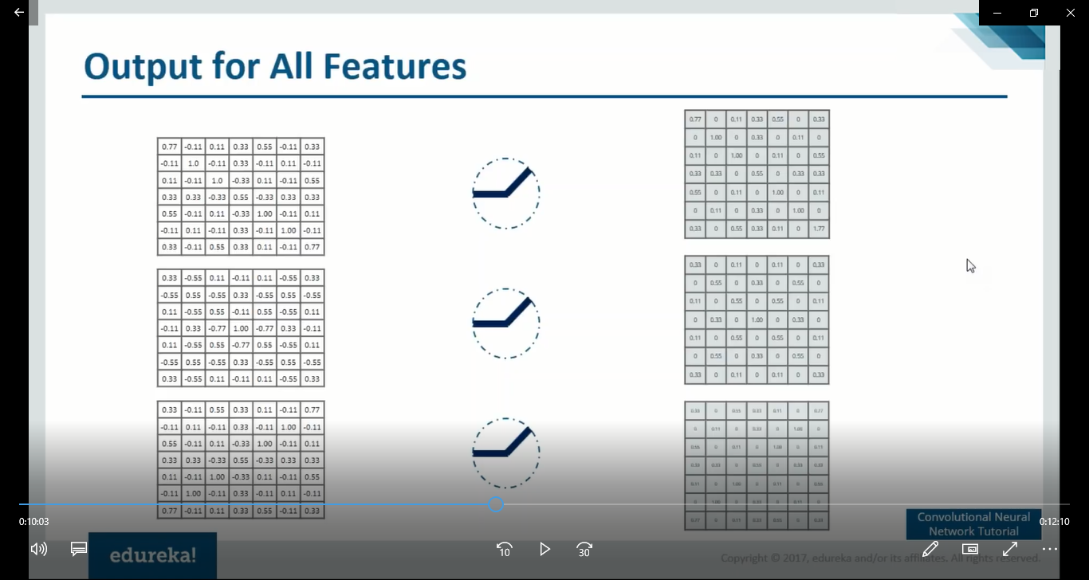

Slide 20
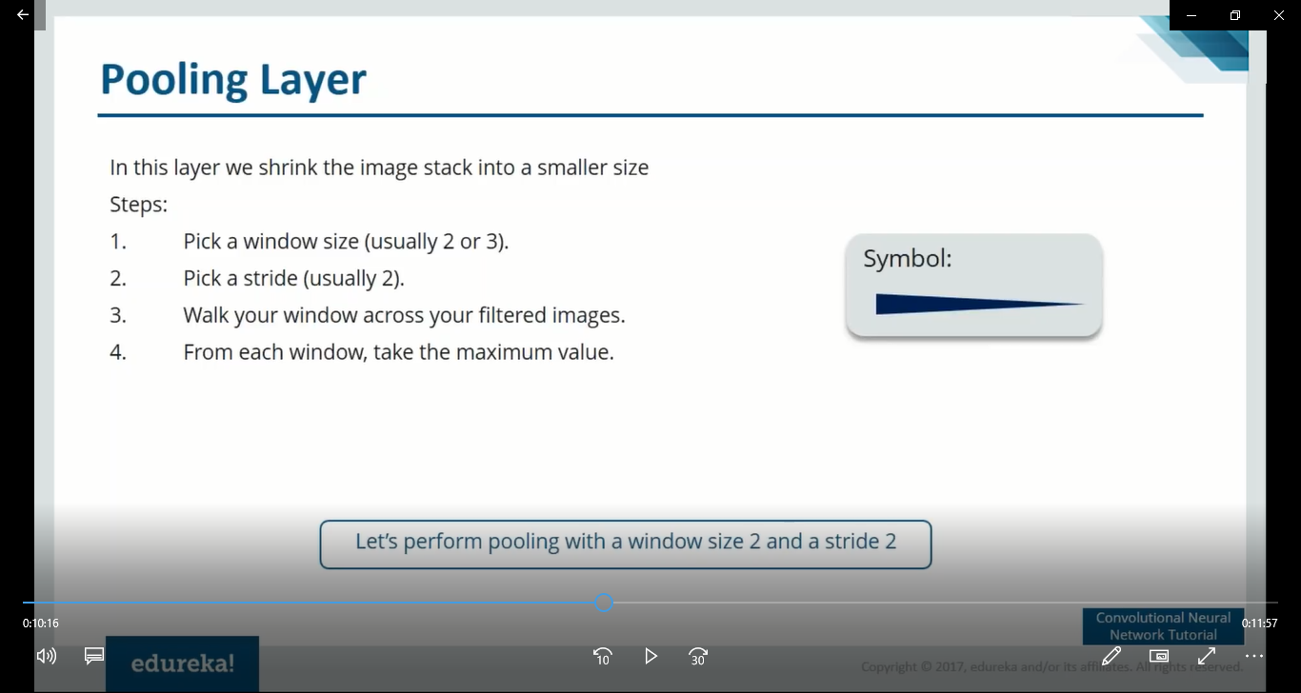

Slide 21
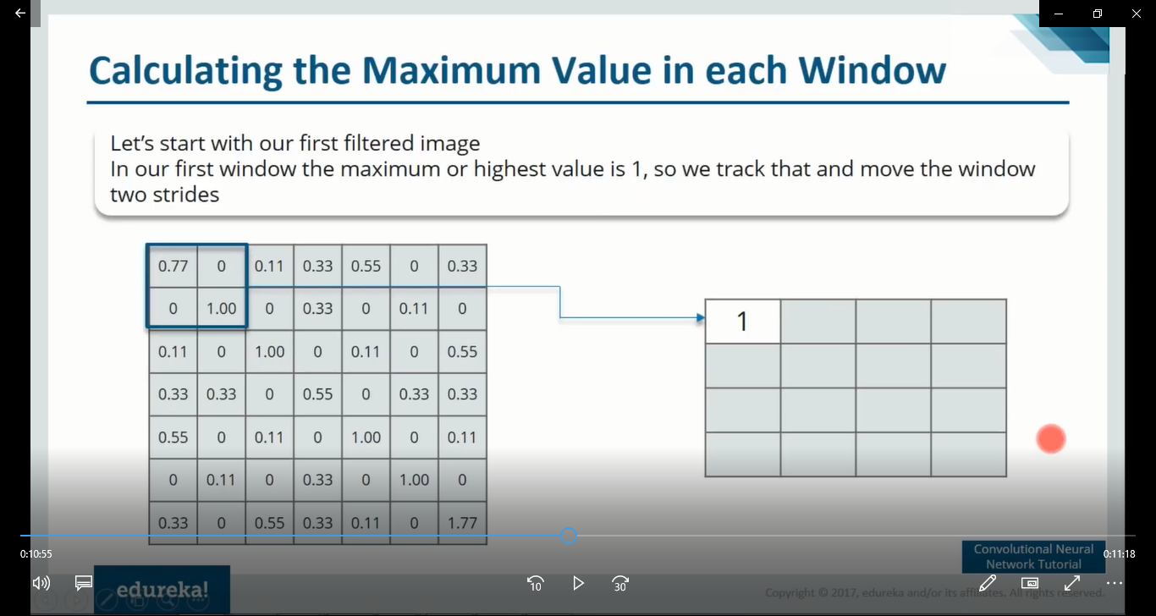

Slide 22
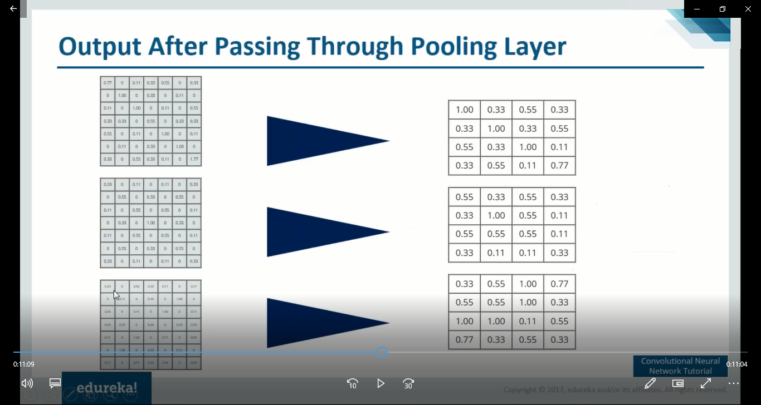

Slide 23
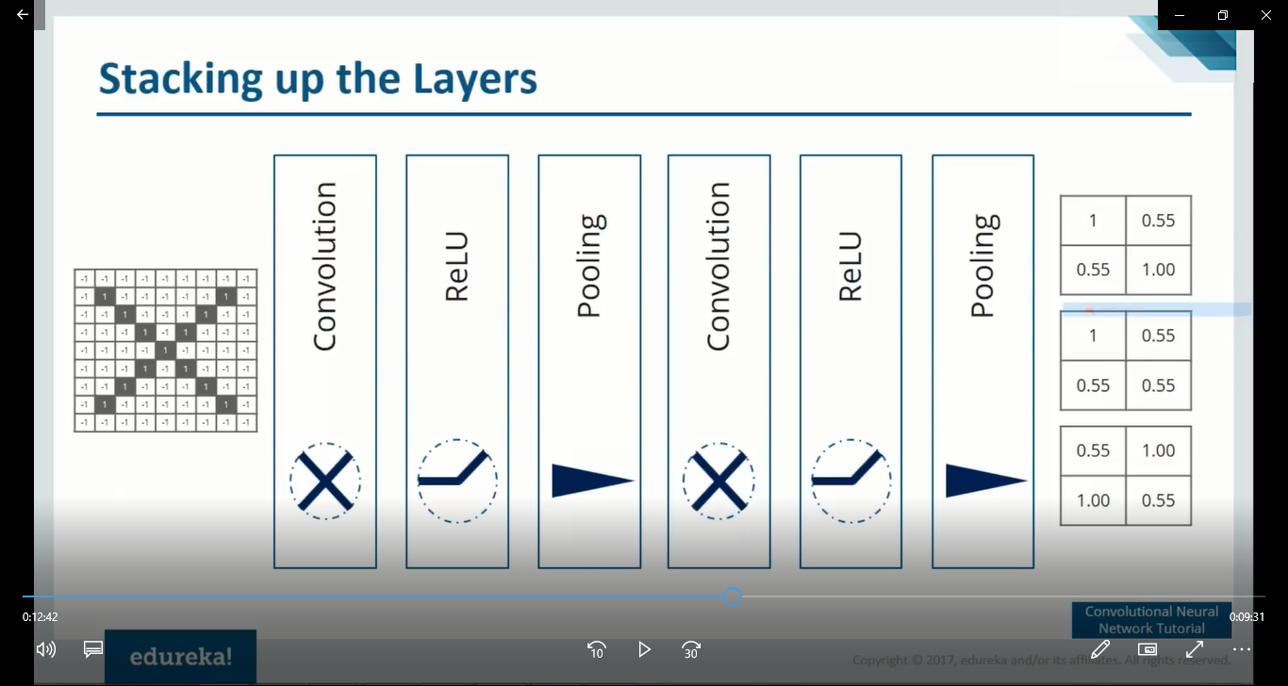

Slide 24
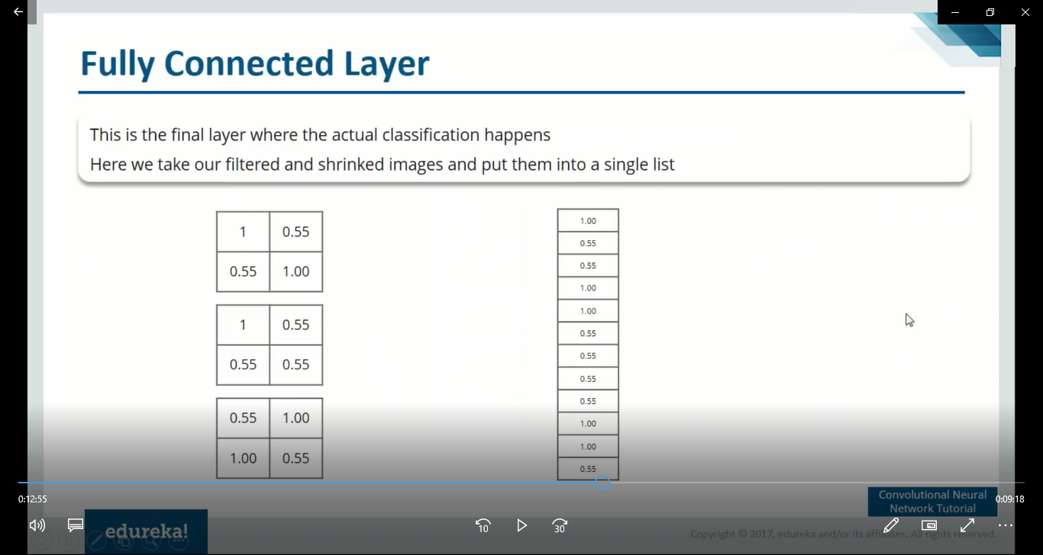

Slide 25
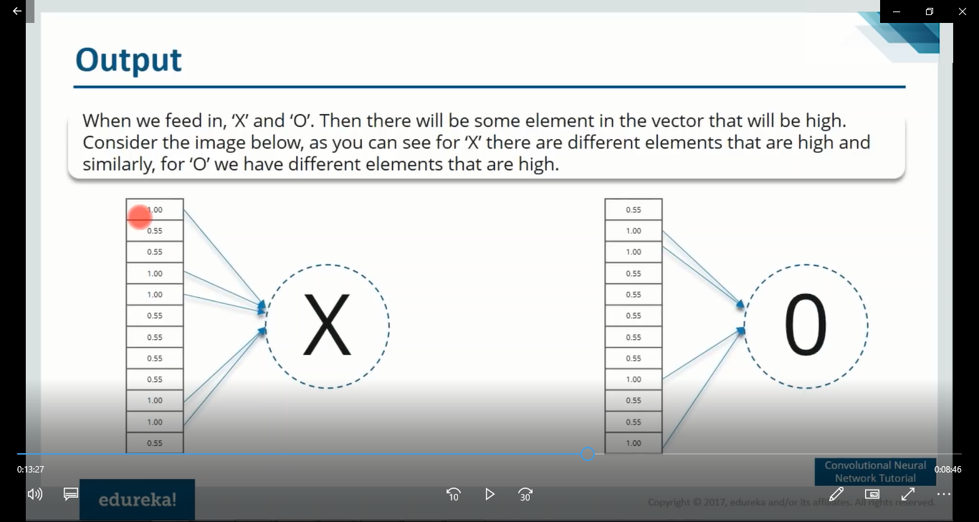
Notes:
Identify the cell locations which provides the highest value for X and Y.
If you zoom the image, you can notice highest value 1 appears for the X in locations such as :-
Cell 1, Cell 4, Cell 5, Cell 10, Cell 11.
Similarly for Y, highest value 1 comes in cell locations such as :-
Cell 2, Cell 3, Cell 9 and Cell 12.

Slide 26
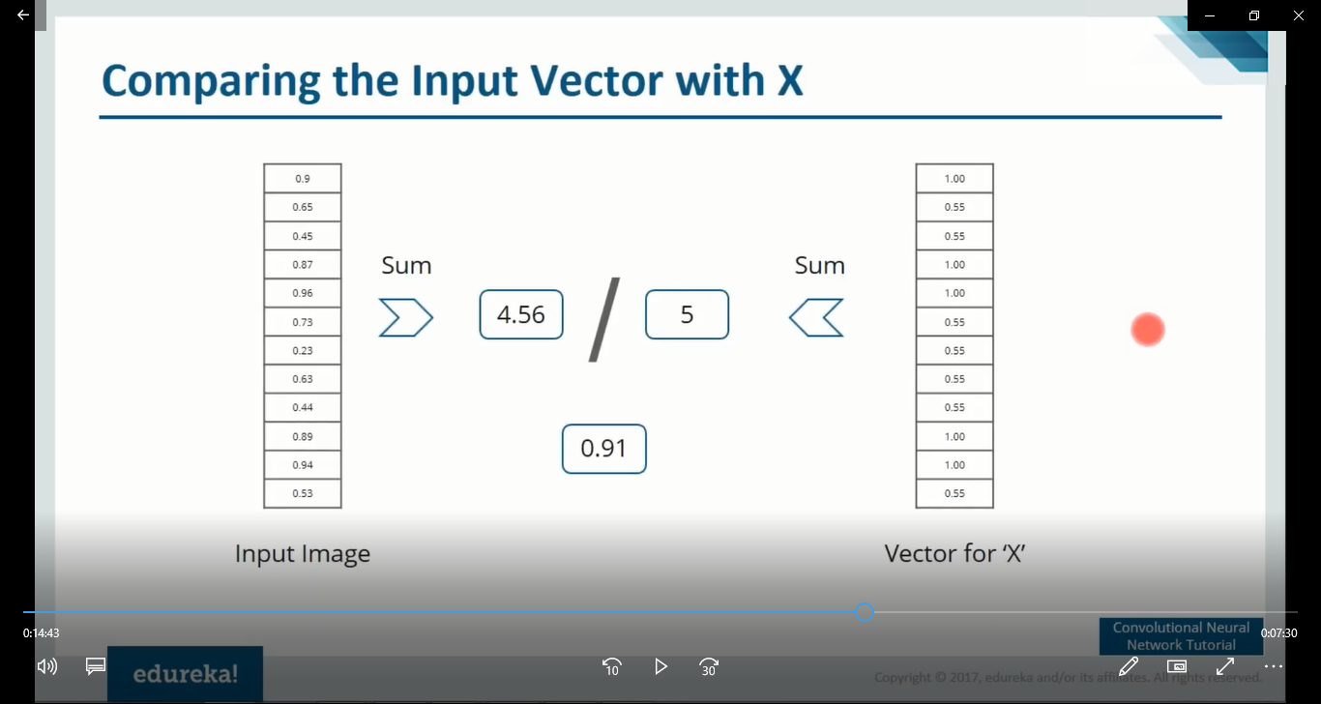
Notes:
Now to test if there is a X in the given image, calculate the value in the fully connected cell locations Cell 1, Cell 4, Cell 5, Cell 10, Cell 11.
In the image :-
Cell 1 – 0.9
Cell 4 – 0.87
Cell 5 – 0.96
Cell 10 – 0.89
Cell 11-0.94
Sum up and total is :- 4.56
Sum up of X`s same cell locations :- 5
Threshold ratio :- 4.56 / 5 🡪 0.91

Slide 27
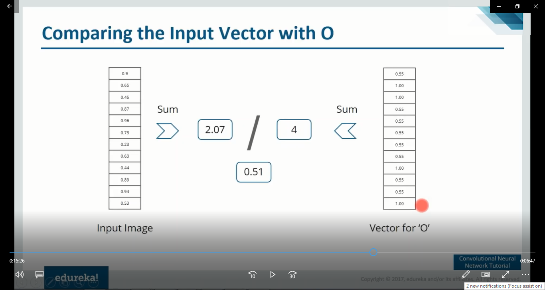
Notes:
Now to test if there is a Y in the given image, calculate the value in the fully connected cell locations Cell 2, Cell 3, Cell 9 and Cell 12.
In the image :-
Cell 2 – 0.65
Cell 3 – 0.45
Cell 9 – 0.44
Cell 12 – 0.53
Sum up and total is :- 2.07
Sum up of Y`s same cell locations :- 4
Threshold ratio :- 4.56 / 5 🡪 0.51

Slide 28
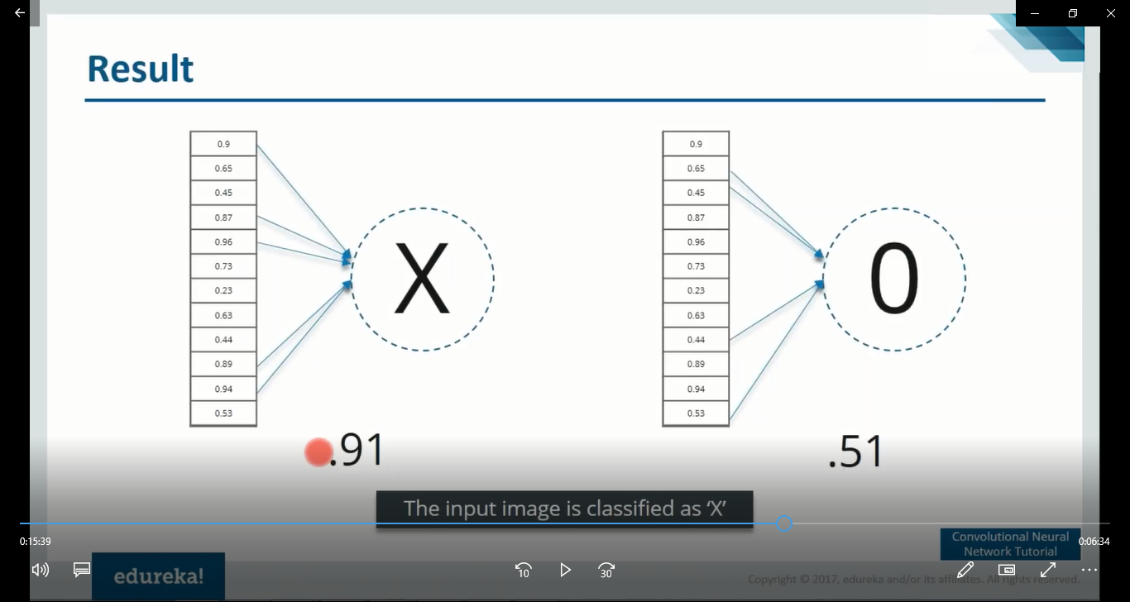
Notes:
Therefore conclusion is there is a X in the given image and not a Y.
Toughly keep in mind, it`s not blindly adding all the cell locations. Only the cell locations of the fully connected layer of the image under concern, which corresponds with the highest values of the feature`s fully connected layers cell locations.

